Slide 1

MANAGEMENT OF INVENTORY SYSTEMS
Introduction to Inventory and Materials Management
PROF PRADIP KUMAR RAY
DEPARTMENT OF INDUSTRIAL AND SYSTEMS ENGINEERING
IIT KHARAGPUR

Slide 2
Sub Topics
Importance of Inventory/Materials Management System, Inventory and its Definitions, Types of Inventory
Why Inventory, Classification of Inventory Problems
Classes of Inventory Problems, Inventory Costs
Types of Inventory and Product Positioning Strategies, Inventory Management and Financial Performance
Concept of Inventory Flow Cycle, Objectives and Decisions of Inventory Control
PROF PRADIP KUMAR RAY
DEPARTMENT OF INDUSTRIAL AND SYSTEMS ENGINEERING
IIT KHARAGPUR

Slide 3
Introduction to Inventory and Materials Management
Importance of Inventory/Materials Management System
Inventory and its Definitions
Types of Inventory
PROF PRADIP KUMAR RAY
DEPARTMENT OF INDUSTRIAL AND SYSTEMS ENGINEERING
IIT KHARAGPUR

Slide 4
Importance of Materials or Inventory Management Systems
Almost all organizations use, transform, distribute, or sell materials of one kind or another.
Inventory investment in any organization may be substantial.
Inventory/Materials Management is one of the most important functions in any organization.
PROF PRADIP KUMAR RAY
DEPARTMENT OF INDUSTRIAL AND SYSTEMS ENGINEERING
IIT KHARAGPUR

Slide 5
Importance of Materials or Inventory Management Systems
The performance (operational and financial) of an organization - manufacturing or service, government or non-government - is significantly dependent on effective management of materials or inventory - made available in a number of forms as they are being processed in a manufacturing/service stage.
Materials management may influence tremendously the cost of production as well as of product.
PROF PRADIP KUMAR RAY
DEPARTMENT OF INDUSTRIAL AND SYSTEMS ENGINEERING
IIT KHARAGPUR

Slide 6
Importance of Materials or Inventory Management Systems
A good and acceptable materials or inventory management system ensures a smooth flow of materials within an organization or a plant. This flow should connect the suppliers to the production systems and subsequently to the customers/end users of the products through the distribution system with generation of minimum or no wastes.
For achieving the main objectives of materials management function as stated above, a total and an integrated inventory management system needs to be developed and used.
PROF PRADIP KUMAR RAY
DEPARTMENT OF INDUSTRIAL AND SYSTEMS ENGINEERING
IIT KHARAGPUR

Slide 7
Inventory and its Definition
The core issue of materials management is maintenance and control of inventory.
This issue is common to all organizations in any sector of the national economy.
The term ‘inventory’ can be interpreted in a number of ways
Stock on hand of materials at a given time.
Tangible asset that can be seen, measured, and counted.
List of items (physical assets).
Quantity of items on hand.
Value of stock of goods owned by an organization at a particular time.
PROF PRADIP KUMAR RAY
DEPARTMENT OF INDUSTRIAL AND SYSTEMS ENGINEERING
IIT KHARAGPUR

Slide 8
Inventory and its Definition
In view of all these interpretations, ‘inventory’ is defined as ‘an idle resource that has an economic value’.
When a resource loses its economic value (after its use in one or multiple cycles), it ceases to be an inventory.
Sometimes, in certain situations, we may be careful in calling items with certain characteristics/features as inventory,
e.g., is ‘hoarding’ an inventory, or is ‘waste’ an inventory?
PROF PRADIP KUMAR RAY
DEPARTMENT OF INDUSTRIAL AND SYSTEMS ENGINEERING
IIT KHARAGPUR

Slide 9
Types of Inventory
The classification of inventory is based on two aspects:
State of inventory
Utility of inventory
Based on state of inventory, it is classified under four categories:
Supplies (in the form of maintenance, repair, and operating supplies or MRO)
Raw materials (R/M)
Work-in-process (WIP)
Finished goods (F/G)
PROF PRADIP KUMAR RAY
DEPARTMENT OF INDUSTRIAL AND SYSTEMS ENGINEERING
IIT KHARAGPUR

Slide 10
Types of Inventory
MRO – not part of final product.
R/M – inputs to production process, usually purchased from suppliers.
WIP – partially completed products still in production process.
F/G – final product, ready for storage, distribution, and sale.
In a production system for a product, these categories of inventory need to be explicitly defined.
As the state of inventory changes, the function or the use of each category of the inventory also changes. This concept is depicted in the figure below:
PROF PRADIP KUMAR RAY
DEPARTMENT OF INDUSTRIAL AND SYSTEMS ENGINEERING
IIT KHARAGPUR

Slide 11
Types of Inventory
State of inventory
Subsequent Function
Sale
F/G
MRO
Idle
Use
R/M
Transform
WIP
Incomplete
Ref: Tersine
PROF PRADIP KUMAR RAY
DEPARTMENT OF INDUSTRIAL AND SYSTEMS ENGINEERING
IIT KHARAGPUR

Slide 12
Types of Inventory
Based on utility of inventory, inventory is classified under six categories:
Working stock (cycle or lot size stock): amount of inventory as determined by its lot size as required to meet its demand for a specific time period.
Safety stock (buffer or fluctuation stock): amount of additional inventory required exclusively as a protection against stock-out situation due to fluctuations of demand during replenishment period.
Anticipation stock (seasonal or stabilization stock): amount of inventory built up to meet the higher or pick seasonal demand.
PROF PRADIP KUMAR RAY
DEPARTMENT OF INDUSTRIAL AND SYSTEMS ENGINEERING
IIT KHARAGPUR

Slide 13
Types of Inventory
Pipeline stock (transit or work-in-process stock): amount of inventory being processed or waiting to be processed, both internally and externally.
Decoupling stock: amount of inventory accumulated between dependent processes or stages so that it can operate independently.
Psychic stock: amount of inventory required to stimulate demand.
PROF PRADIP KUMAR RAY
DEPARTMENT OF INDUSTRIAL AND SYSTEMS ENGINEERING
IIT KHARAGPUR

Slide 14
Introduction to Inventory and Materials Management
Why Inventory
Classification of Inventory Problems
PROF PRADIP KUMAR RAY
DEPARTMENT OF INDUSTRIAL AND SYSTEMS ENGINEERING
IIT KHARAGPUR

Slide 15
Why Inventory
Inventory is needed to meet demand. Demand occurs at instant of time or during a period of time.
If supply is made as and when demand occurs, there is no need of inventory – a perfect match between supply and demand.
However, such a condition, in all likelihood, can rarely be achieved due to many kinds of practical difficulties and constraints, like can it be possible to arrange instantaneous production/supply as soon as the demand occurs – even if with demand of small quantity and there is on-time real-time information control system related to inventory management in place, creation of inventory with its acceptable value, quality, and quantity needs certain time.
PROF PRADIP KUMAR RAY
DEPARTMENT OF INDUSTRIAL AND SYSTEMS ENGINEERING
IIT KHARAGPUR

Slide 16
Why Inventory
In this context, there are four possible reasons for existence of inventory in any system:
Time factor, Discontinuity factor, Uncertainty factor, and Economy factor.
Time factor: Creation and supply of inventory needs time.
Discontinuity factor: As each stage of production must act independently from other stages or processes in production and post-production phases, inventory allows a process or a stage to act independently even it there is discontinuity in operation, due to some reasons, at the precedent or subsequent process or stage.
PROF PRADIP KUMAR RAY
DEPARTMENT OF INDUSTRIAL AND SYSTEMS ENGINEERING
IIT KHARAGPUR

Slide 17
Why Inventory
Uncertainty factor: Inventory offers protection against unplanned and unanticipated occurrences of events that may affect supply system. Such factors may be of many types, including ‘Acts of God’.
Economy factor: Inventory offers cost-reduction advantages when bulk purchases with quantity discounts is allowed or when procurement at lowest price in condition of seasonal price fluctuation is justified.
PROF PRADIP KUMAR RAY
DEPARTMENT OF INDUSTRIAL AND SYSTEMS ENGINEERING
IIT KHARAGPUR

Slide 18
Classification of Inventory Problems
Before we attempt to classify inventory problems as they exist in manufacturing or service organizations, it is pertinent to know what is to be determined related to inventory management for an item/for specific questions need to answered against an item:
When to order for this item? (time)
How much to order for this item? (quantity)
PROF PRADIP KUMAR RAY
DEPARTMENT OF INDUSTRIAL AND SYSTEMS ENGINEERING
IIT KHARAGPUR

Slide 19
Classification of Inventory Problems
Hence, there are two parameters, related to above questions, for any inventory control system.
A number of factors may affect this inventory problem.
Each of these factors may have different levels.
Combinations of the types and levels of these factors determine classes of inventory problems.
PROF PRADIP KUMAR RAY
DEPARTMENT OF INDUSTRIAL AND SYSTEMS ENGINEERING
IIT KHARAGPUR

Slide 20
Classification of Inventory Problems
The following factors need to be considered for classification:
Knowledge of demand: Demand may be in two types
Independent demand e.g. demand of F/G, final product.
or
Dependent demand e.g. demand of R/M depends on demand of F/G (as per BOM of the F/G or the final product)
PROF PRADIP KUMAR RAY
DEPARTMENT OF INDUSTRIAL AND SYSTEMS ENGINEERING
IIT KHARAGPUR

Slide 21
Classification of Inventory Problems
Constant demand (or demand under certainty): demand level is known exactly
or
Variable demand: this may be defined in two ways:
Demand under risk: when probability distribution of demand is known.
Demand under uncertainty: when even probability distribution of demand is not known, only partial information related to demand is made available.
PROF PRADIP KUMAR RAY
DEPARTMENT OF INDUSTRIAL AND SYSTEMS ENGINEERING
IIT KHARAGPUR

Slide 22
Classification of Inventory Problems
Source of Supply: This may be of two types:
Outside supply: item is procured from outside supplier
Inside supply: item is supplied from inside (self-supplying)
Decision process (repetitiveness): This may be of two types:
One-period decision (static): Single order, specific time period during which only demand exists.
Multi-period decision (dynamic): Repeat orders, demand exists for countably infinite time period, item being produced regularly.
PROF PRADIP KUMAR RAY
DEPARTMENT OF INDUSTRIAL AND SYSTEMS ENGINEERING
IIT KHARAGPUR

Slide 23
Classification of Inventory Problems
Knowledge of lead time or lag time (time lag in receiving order): Time between placement of an order and receipt of its supply. This may be of two types:
Constant Lead Time (CLT)
Variable Lead Time (VLT): Probability distribution of lead time is known or specified.
PROF PRADIP KUMAR RAY
DEPARTMENT OF INDUSTRIAL AND SYSTEMS ENGINEERING
IIT KHARAGPUR

Slide 24
Classification of Inventory Problems
Inventory Control System: For any item, its inventory control system can be decided independently. A large number of such control systems have been developed by researchers and practitioners, and are in use.
Among a large number of such systems, the following control systems are widely used:
Perpetual (or Continuous) Review (P1)
Periodic Review (P2)
Material Requirements Planning (MRP) (P3)
Distribution Requirements Planning (DRP) (P4)
Single Order Quantity (P5)
PROF PRADIP KUMAR RAY
DEPARTMENT OF INDUSTRIAL AND SYSTEMS ENGINEERING
IIT KHARAGPUR

Slide 25
Classification of Inventory Problems
Over and above these factors as stated, the demand distribution over time may be assumed to be fixed (stationary) or variable (non-stationary).
Inventory control classification may be depicted with the following Figure:
PROF PRADIP KUMAR RAY
DEPARTMENT OF INDUSTRIAL AND SYSTEMS ENGINEERING
IIT KHARAGPUR

Slide 26
P1
P2
CLT
P4
VLT
P1
Independent Demand
P2
CLT
P4
Dependent Demand
VLT
Supply (Outside)
P3
CLT
VLT
P1
Supply (Inside)
ID
P2
Multi-order (Dynamic)
DD
CLT
P4
VLT
P1
CLT
P2
CD
VLT
P4
VD
CLT
Single-order (Static)
Supply (Outside)
VLT
CLT
P5
Supply (Inside)
CD
VLT
VD
CLT
VLT
PROF PRADIP KUMAR RAY
DEPARTMENT OF INDUSTRIAL AND SYSTEMS ENGINEERING
IIT KHARAGPUR

Slide 27
Introduction to Inventory and Materials Management
Classes of Inventory Problems
Inventory Costs
PROF PRADIP KUMAR RAY
DEPARTMENT OF INDUSTRIAL AND SYSTEMS ENGINEERING
IIT KHARAGPUR

Slide 28
Classification of Inventory Problems
Each class of inventory problem is represented by a route as depicted in the Figure.
In simplest form, the inventory problems can be classified as per the following schemes:
Type of problem (Supply) | Demand
 | Certainty | Risk | Uncertainty
Static | *
Dynamic
PROF PRADIP KUMAR RAY
DEPARTMENT OF INDUSTRIAL AND SYSTEMS ENGINEERING
IIT KHARAGPUR

Slide 29
Classification of Inventory Problems
There are six classes of problems.
However, static inventory problem under certainty does not come under inventory problem as two decisions (when to order and how much to order) can be made without even formulating the problem. The decisions are already known. Only when a number of items are considered under this class, the problem may be referred to as a typical scheduling problem.
PROF PRADIP KUMAR RAY
DEPARTMENT OF INDUSTRIAL AND SYSTEMS ENGINEERING
IIT KHARAGPUR

Slide 30
Inventory Costs
While formulating any class of problem, we need to know the working of the inventory control system, its parameters, the constraints, if any, and assumptions for modelling.
Usually the values of these parameters are determined such that the cost of the inventory control system under consideration is held at a minimum level.
In this context, the types of inventory-related costs are to be known and identified.
PROF PRADIP KUMAR RAY
DEPARTMENT OF INDUSTRIAL AND SYSTEMS ENGINEERING
IIT KHARAGPUR

Slide 31
Inventory Costs
There are a number of inventory-related costs that need to be considered. These costs are as follows:
Purchase Cost: This is also known as procurement cost. While an item is purchased from an outside source (supplier), unit purchase price for the item determines the purchase cost.
Setup Cost: This cost is relevant when the item is supplied from within (self-supply). The cost associated with setting up of the process or the machinery as per production run and lot size is the setup cost. It is usually measured per setup basis.
PROF PRADIP KUMAR RAY
DEPARTMENT OF INDUSTRIAL AND SYSTEMS ENGINEERING
IIT KHARAGPUR

Slide 32
Inventory Costs
Production Cost: This is incurred when the item in required quantity is produced by the production department (self-supply). The production cost per unit is its measure.
Order Cost: This cost is relevant when the item is supplied from outside (supplier). An authorization note, in the form of purchase order, is to be placed to the supplier. The cost of preparing and placing the order for the item in required quantity and quality under agreed terms and conditions is referred to as the order cost. Usually, it is measured per order basis.
PROF PRADIP KUMAR RAY
DEPARTMENT OF INDUSTRIAL AND SYSTEMS ENGINEERING
IIT KHARAGPUR

Slide 33
Inventory Costs
Inventory Carrying or Holding Cost: This is essentially the cost of money tied up in inventory. There is a time lag between the arrival/production of inventory and its use. While it is stored for the time period, it is essential that it is kept in good condition. The costs associated with the lost earning power (due to cost of the money tied up in inventory without getting the return if this tied up money were invested elsewhere), storage, deterioration, insurance, and other prevention measures taken to maintain inventory of the item in acceptable/usable condition. This cost is measured either as a proportion/percent of the cost of average inventory or as a cost per unit price of the item (in absolute term).
PROF PRADIP KUMAR RAY
DEPARTMENT OF INDUSTRIAL AND SYSTEMS ENGINEERING
IIT KHARAGPUR

Slide 34
Inventory Costs
Overstock Cost: This cost is incurred when supply is more than demand, and at the end of the selling season, an extra amount of inventory beyond demand is kept. Elimination or at least, minimization of overstock amount is one of the main objectives of any inventory control system.
Understock Cost: Also referred to as ‘out-of-stock’ or ‘stockout’ cost, this is incurred when supply is less than demand during a period of time. Depending on the response of the customer to unfulfilled demand, there may be two types of understock cost: Backordering Cost (in case unfulfilled demand remains and can be met later or next time period) and Lost Sales Cost (in case unfulfilled demand is lost forever and cannot be met later or next time period).
PROF PRADIP KUMAR RAY
DEPARTMENT OF INDUSTRIAL AND SYSTEMS ENGINEERING
IIT KHARAGPUR

Slide 35
Inventory Costs
Among these costs, the Purchase Cost is considered a fixed cost as it remains same irrespective of order quantity, number of orders, and ordering cycles or ordering period.
Other types of costs as stated are considered a variable cost as these costs are dependent on inventory control system or policy.
While formulating a problem, Understock Cost may be assumed to be a constant (irrespective of amount of shortages) or a variable (per unit of shortage).
PROF PRADIP KUMAR RAY
DEPARTMENT OF INDUSTRIAL AND SYSTEMS ENGINEERING
IIT KHARAGPUR

Slide 36
Inventory Costs
While formulating an inventory control problem, we need to identify, and consider those costs found relevant in a given problem.
An important type of cost, called Systemic or Implementation Cost (cost incurred for making changes in the system) needs to be considered when a new or better inventory control system is introduced for an item.
In this context, as an example from a typical production system, the inventory cost accumulation profile is presented in the following Figure:
PROF PRADIP KUMAR RAY
DEPARTMENT OF INDUSTRIAL AND SYSTEMS ENGINEERING
IIT KHARAGPUR

Slide 37
Inventory Costs
C
Storage
In a repetitive manufacturing system, (batch production), the cost profile consists of Material cost (OA), Labour cost (AB), Overhead cost (BC), and Total Product cost (OC)
B
Assembly
Storage
Subassembly
Storage
Fabrication
Storage
A
R/M
F/G
O
Manufacturing Cycle time
Throughput time
Material Acquisition
Product Shipment
PROF PRADIP KUMAR RAY
DEPARTMENT OF INDUSTRIAL AND SYSTEMS ENGINEERING
IIT KHARAGPUR

Slide 38
Introduction to Inventory and Materials Management
Types of Inventory and Product Positioning Strategies
Inventory Management and Financial Performance
PROF PRADIP KUMAR RAY
DEPARTMENT OF INDUSTRIAL AND SYSTEMS ENGINEERING
IIT KHARAGPUR

Slide 39
Types of Inventory and Product Positioning Strategies
Manufacturing companies may have different strategies for product manufacturing and selling. These are referred to as ‘product positioning strategies’ that have a bearing on the kinds of inventory to be stocked and processed.
There may be many types of product positioning strategies. Some of the important product positioning strategies are: Make-to-Stock, Assemble-to-Order, Make-to-Order, and Engineer-to-Order.
PROF PRADIP KUMAR RAY
DEPARTMENT OF INDUSTRIAL AND SYSTEMS ENGINEERING
IIT KHARAGPUR

Slide 40
Types of Inventory and Product Positioning Strategies
These strategies are briefly explained below:
Make-to-Stock: concerns availability of F/G when order is received.
Assemble-to-Order: concerns assembly of a group of parts/subassemblies available as inventory when order is received.
Make-to-Order: concerns manufacturing of parts and assembly for the final product, in inventory, when order is received.
Engineer-to-Order: concerns design and manufacture of specialty products with required inventory as per order requirements.
PROF PRADIP KUMAR RAY
DEPARTMENT OF INDUSTRIAL AND SYSTEMS ENGINEERING
IIT KHARAGPUR

Slide 41
Inventory Management and Financial Performance
In any organization, financial performance is closely linked with inventory management. If inventory management is poor, financial performance goes down.
An efficient inventory management ensures a healthy working capital.
For continual assessment of financial performance, two important documents are prepared at regular intervals, as per statutory obligation, and reviewed for understanding the growth or decline of financial health of any organization or company:
PROF PRADIP KUMAR RAY
DEPARTMENT OF INDUSTRIAL AND SYSTEMS ENGINEERING
IIT KHARAGPUR

Slide 42
Inventory Management and Financial Performance
Balance sheet, equating assets with liabilities and owners’ equity at any instant of time.
Profit and loss statement, representing relationship between sales and profit during a period of time.
Inventory, being one of the current assets, significantly affects the performance in both counts.
PROF PRADIP KUMAR RAY
DEPARTMENT OF INDUSTRIAL AND SYSTEMS ENGINEERING
IIT KHARAGPUR

Slide 43
Typical Balance Sheet
Current Asset | (in Rupees) | Current Liabilities | (in Rupees)
Cash and securities | 40,000 | Accounts payable | 80,000
Accounts receivable | 100,000 | Notes payable | 20,000
Inventory | 300,000 | Accrued expenses | 10,000
Prepaid expenses | 10,000 | Current Long term debt | 50,000
Fixed Asset |  | Long Tong Term Debt | 300,000
Net plant & equipment | 550,000
 |  | Owners' Equity
 |  | Preferred stock | 140,000
 |  | Common stock | 300,000
 |  | Retained earnings | 100,000
Total Assets | 1,000,000 | Total Liabilities & Owners’ Equity | 1,000,000
PROF PRADIP KUMAR RAY
DEPARTMENT OF INDUSTRIAL AND SYSTEMS ENGINEERING
IIT KHARAGPUR

Slide 44
Typical Profit and Loss Statement
Sales |  | 1,000,000
Direct material | 400,000
Direct labor | 200,000
Factory overhead | 100,000
Cost of Goods Sold | 700,000 | -700,000
Gross Profit |  | 300,000
Selling expenses | 50,000
Administrative expense | 100,000
Total Selling/ Administrative Expense | 150,000 | -150,000
Operating Income |  | 150,000
Interest Expense |  | -50,000
Net Income Before Taxes |  | 100,000
PROF PRADIP KUMAR RAY
DEPARTMENT OF INDUSTRIAL AND SYSTEMS ENGINEERING
IIT KHARAGPUR

Slide 45
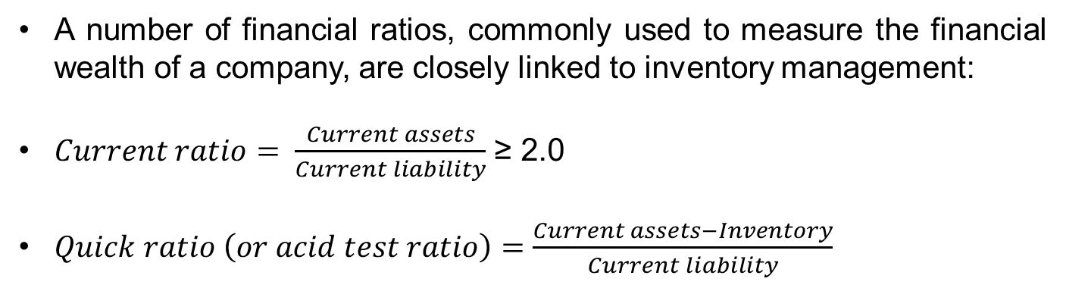
Inventory Management and Financial Performance
PROF PRADIP KUMAR RAY
DEPARTMENT OF INDUSTRIAL AND SYSTEMS ENGINEERING
IIT KHARAGPUR

Slide 46
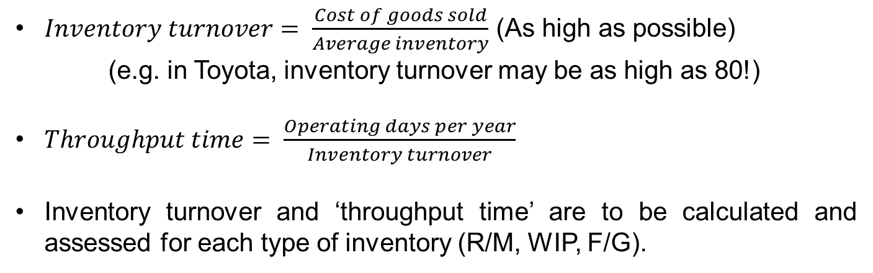
Inventory Management and Financial Performance
PROF PRADIP KUMAR RAY
DEPARTMENT OF INDUSTRIAL AND SYSTEMS ENGINEERING
IIT KHARAGPUR

Slide 47
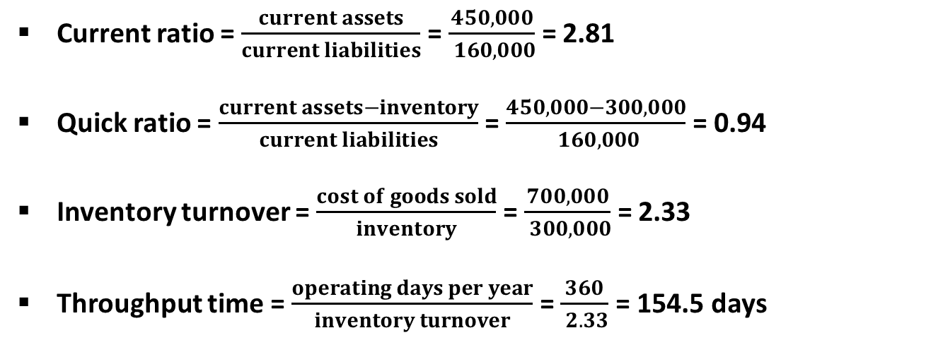
Inventory Management and Financial Performance
PROF PRADIP KUMAR RAY
DEPARTMENT OF INDUSTRIAL AND SYSTEMS ENGINEERING
IIT KHARAGPUR

Slide 48
Inventory Management and Financial Performance
In today’s industrial context, JIT concept as developed in Japanese organizations, needs to be applied to develop the best possible inventory management system in an organization with the assurance of minimum waste, maximum turnover, and minimum cost of inventory.
PROF PRADIP KUMAR RAY
DEPARTMENT OF INDUSTRIAL AND SYSTEMS ENGINEERING
IIT KHARAGPUR

Slide 49
Inventory Management and Financial Performance
Organizational objectives, such as profitability and market share, are closely linked with how the manufacturing system is being run achieving a condition where minimum manufacturing lead time, maximum quality with minimum wastage, and minimum production cost are ensured.
For assurance of such a condition, we need to analyze and control the existing inventory flow cycle within a manufacturing system.
PROF PRADIP KUMAR RAY
DEPARTMENT OF INDUSTRIAL AND SYSTEMS ENGINEERING
IIT KHARAGPUR

Slide 50
Introduction to Inventory and Materials Management
Concept of Inventory Flow Cycle
Objectives and Decisions of Inventory Control
PROF PRADIP KUMAR RAY
DEPARTMENT OF INDUSTRIAL AND SYSTEMS ENGINEERING
IIT KHARAGPUR

Slide 51
Concept of Inventory Flow Cycle
Inventory management system in any organization involves controlling the flow rates of materials from upstream to downstream process.
The flow rate of materials (inventory) through the system depends on a number of factors:
Level of supply and purchasing rate in respect of R/M
Production control-related R/M and WIP
Marketing rate in respect of F/G and level of demand
The flow rates across the system balance supply with demand.
A typical inventory flow cycle for manufacturing system is shown in the Figure:
PROF PRADIP KUMAR RAY
DEPARTMENT OF INDUSTRIAL AND SYSTEMS ENGINEERING
IIT KHARAGPUR

Slide 52
Concept of Inventory Flow Cycle
Supply
Purchasing
R/M and Supplies
Production control
WIP
Production control
F/G
Marketing
Demand
PROF PRADIP KUMAR RAY
DEPARTMENT OF INDUSTRIAL AND SYSTEMS ENGINEERING
IIT KHARAGPUR

Slide 53
Concept of Inventory Flow Cycle
How would you represent mathematically the relationship between supply and demand considering flow rates of different types of inventory with relevant control parameters?
PROF PRADIP KUMAR RAY
DEPARTMENT OF INDUSTRIAL AND SYSTEMS ENGINEERING
IIT KHARAGPUR

Slide 54
Concept of Inventory Flow Cycle
In this context, the application of Theory of Constraints is relevant.
In Theory of Constraints, we need to balance the flow rate of materials in different forms among different stages/resources of a manufacturing system.
While you try to maintain a balanced workflow of materials in the system determining the system performance, we need to look into the relationship between capacity and demand with respect to a particular resource treated as an inventory itself like a capital equipment.
These resources are classified under two categories: (i) Bottleneck: capacity is less than demand, and (ii) Non-bottleneck: capacity is greater than demand.
PROF PRADIP KUMAR RAY
DEPARTMENT OF INDUSTRIAL AND SYSTEMS ENGINEERING
IIT KHARAGPUR

Slide 55
Concept of Inventory Flow Cycle
While we study the inventory flow system, we need to increase the flow rate of inventory from a bottleneck resource.
Inventory control systems are developed and updated in such a way that there is always a scope of improvement in the utilization of bottleneck resources.
Under Theory of Constraints, the meaning of the term, inventory, is the amount of money invested in plant, equipment, and materials for producing the ‘throughput’, the amount of actual sales made.
The details of Theory of Constraints specifically in relation to inventory management will be discussed in Week-10.
PROF PRADIP KUMAR RAY
DEPARTMENT OF INDUSTRIAL AND SYSTEMS ENGINEERING
IIT KHARAGPUR

Slide 56
Objectives of Inventory Management System
The objectives of any inventory management system are manifold:
Elimination/minimization of overstock.
Elimination/minimization of understock.
Minimization of inventory investment.
Shortening of production throughput time.
Assurance of smooth flow of inventory (in different forms) within the organizational process.
For inventory control of an item, the decision may be of two types:
If mathematical modelling is necessary for analysis and control of inventory, or
If on-time real-time control is necessary.
PROF PRADIP KUMAR RAY
DEPARTMENT OF INDUSTRIAL AND SYSTEMS ENGINEERING
IIT KHARAGPUR

Slide 57
Thank You!!

